Slide 1
2
A Further Look at Financial
Statements
Kimmel ● Weygandt ● Kieso
Financial Accounting, Eighth Edition

Slide 2
CHAPTER OUTLINE
LEARNING OBJECTIVES
Identify the sections of a classified balance sheet.
1
Use ratios to evaluate a company’s profitability, liquidity, and solvency.
2
Discuss financial reporting concepts.
3

Slide 3
LEARNING OBJECTIVE
1
Identify the sections of a classified balance sheet.
Presents a snapshot at a point in time.
To improve understanding, companies group similar assets and similar liabilities together.
Standard Classifications
Assets Liabilities and Stockholders’ Equity
Current assets Current liabilities
Long-term investments Long-term liabilities
Property, plant, and equipment Stockholders’ equity
Intangible assets
ILLUSTRATION 2-1
Standard balance sheet classifications
LO 1

Slide 4
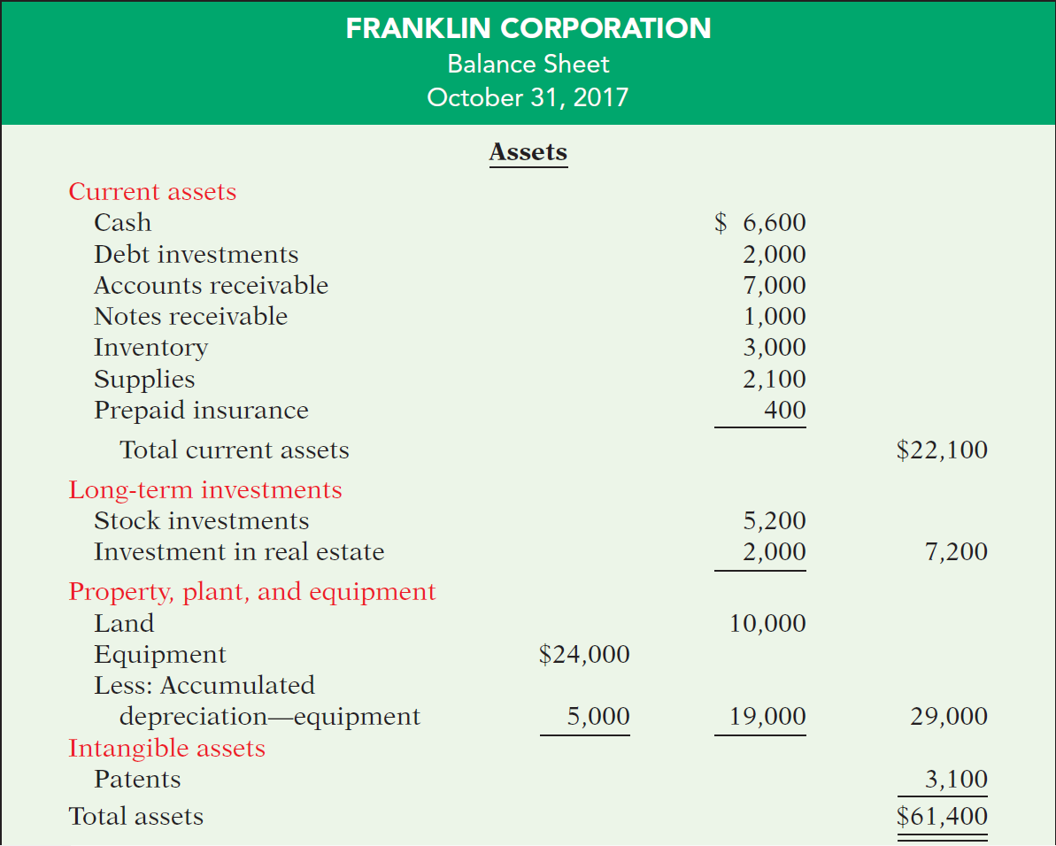
ILLUSTRATION 2-2
Classified balance sheet
LO 1

Slide 5
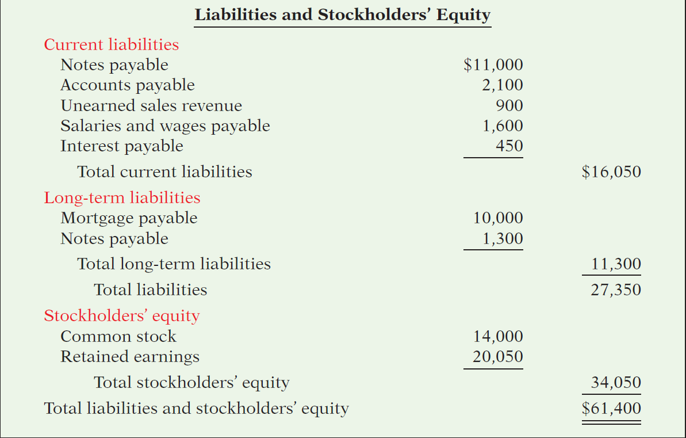
ILLUSTRATION 2-2
Classified balance sheet
LO 1

Slide 6
THE CLASSIFIED BALANCE SHEET
Current Assets
Assets that a company expects to convert to cash or use up within one year or the operating cycle, whichever is longer.
Operating cycle is the average time it takes from the purchase of inventory, to the sale of goods, and then to the collection of cash from customers.
Common types of current assets are (1) cash, (2) investments, (3) receivables, (4) inventories, and (5) prepaid expenses.
LO 1

Slide 7
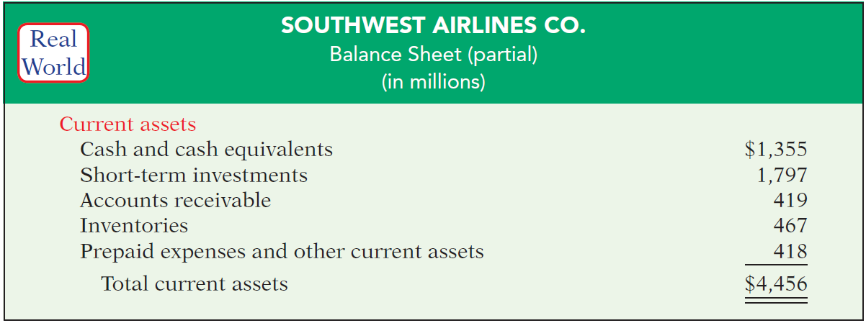
THE CLASSIFIED BALANCE SHEET
Current Assets
Illustration 2-3
Current assets section
Companies list current asset accounts in the order they expect to convert them into cash.
LO 1

Slide 8
THE CLASSIFIED BALANCE SHEET
Review Question
Cash, and other resources that are reasonably expected to be realized in cash or sold or consumed in the business within one year or the operating cycle, are called:
Current assets.
Intangible assets.
Long-term investments.
Property, plant, and equipment.
LO 1

Slide 9
THE CLASSIFIED BALANCE SHEET
Long-Term Investments
Investments in stocks and bonds of other corporations that are held for more than one year.
Long-term assets such as land or buildings that a company is not currently using in its operating activities.
Long-term notes receivable.
ILLUSTRATION 2-4
Long-term investments section
LO 1

Slide 10
THE CLASSIFIED BALANCE SHEET
Property, Plant, and Equipment
Long useful lives.
Currently used in operations.
Includes land, buildings, equipment, delivery vehicles, and furniture.
Depreciation - allocating the cost of assets to a number of years. MORE ON THIS LATER
Accumulated depreciation - total amount of depreciation expensed thus far in the asset’s life.
Alternative Terminology
Property, plant, and equipment is sometimes called fixed assets or plant assets.
LO 1

Slide 11
Property, Plant, and Equipment
ILLUSTRATION 2-5
Property, plant, and equipment section
LO 1

Slide 12
THE CLASSIFIED BALANCE SHEET
Intangible Assets
▼Helpful Hint Sometimes intangible assets are reported
under a broader heading called “Other assets.”
Assets that do not have physical substance.
Includes goodwill, patents, copyrights, and trademarks or trade names.
LO 1

Slide 13
THE CLASSIFIED BALANCE SHEET
Intangible Assets
ILLUSTRATION 2-6
Intangible assets section
Illustration 2-6
LO 1

Slide 14
THE CLASSIFIED BALANCE SHEET
Review Question
Patents and copyrights are
Current assets.
Intangible assets.
Long-term investments.
Property, plant, and equipment.
LO 1

Slide 15
DO IT!
1a
Assets Section of Classified Balance Sheet
Baxter Hoffman recently received the following information related to Hoffman Corporation’s December 31, 2017, balance sheet.
Prepaid insurance $ 2,300 Inventory $3,400
Cash 800 Accumulated depreciation—
Equipment 10,700 equipment 2,700
Accounts receivable 1,100
Prepare the assets section of Hoffman Corporation’s classified balance sheet.
LO 1

Slide 16
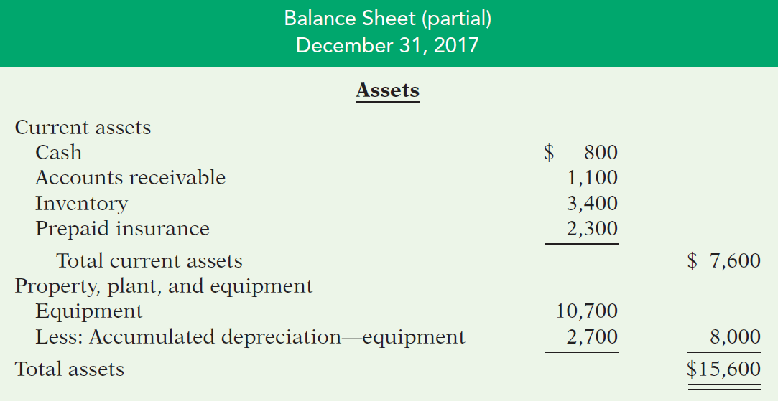
Prepare the assets section of the classified balance sheet.
Prepaid insurance $ 2,300 Inventory $3,400
Cash 800 Accumulated depreciation—
Equipment 10,700 equipment 2,700
Accounts receivable 1,100

Slide 17
THE CLASSIFIED BALANCE SHEET
Current Liabilities
Obligations the company is to pay within the next year or operating cycle, whichever is longer.
Common examples are accounts payable, salaries and wages payable, notes payable, interest payable, and income taxes payable.
Also included as current liabilities are current maturities of long-term obligations—payments to be made within the next year on long-term obligations.
LO 1

Slide 18
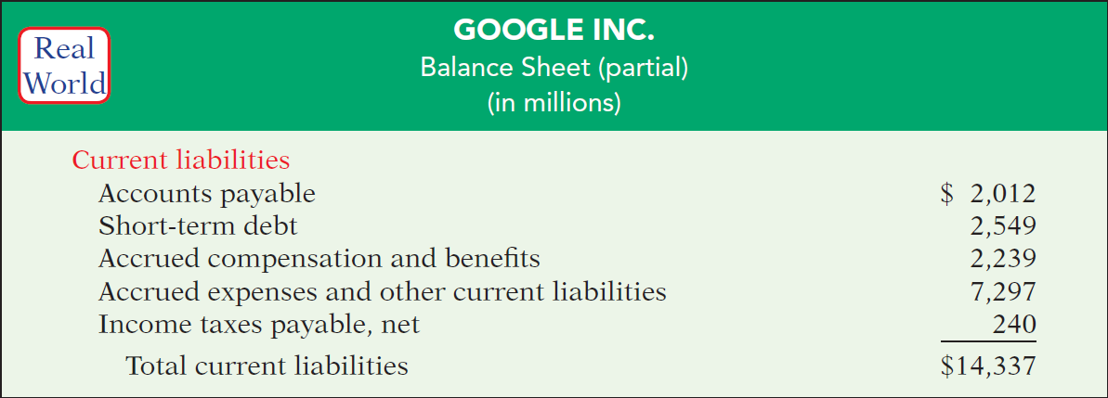
THE CLASSIFIED BALANCE SHEET
Current Liabilities
ILLUSTRATION 2-7
Current liabilities section
LO 1

Slide 19
THE CLASSIFIED BALANCE SHEET
Long-Term Liabilities
Obligations a company expects to pay after one year.
Include bonds payable, mortgages payable, long-term notes payable, lease liabilities, and pension liabilities.
ILLUSTRATION 2-8
Long-term liabilities section
LO 1

Slide 20
THE CLASSIFIED BALANCE SHEET
Review Question
Which of the following is not a long-term liability?
Bonds payable.
Current maturities of long-term debt.
Long-term notes payable.
Mortgages payable.
LO 1

Slide 21
THE CLASSIFIED BALANCE SHEET
Stockholders’ Equity
Common stock - investments of assets into the business by the stockholders.
Retained earnings - income retained for use in the business
Stockholders’ Equity section for Franklin Corporation
Illustration 2-2
LO 1

Slide 22
DO IT!
1b
Balance Sheet Classifications
Match each of the items to its proper balance sheet classification, shown below. If the item would not appear on a balance sheet, use “NA.”
Current assets (CA) Current liabilities (CL)
Long-term investments (LTI) Long-term liabilities (LTL)
Property, plant, and equipment (PPE) Stockholders’ equity (SE)
Intangible assets (IA)
Solution
CL Salaries and wages payable LTI Investment in real estate
NA Service revenue PPE Equipment
CL Interest payable PPE Accumulated depreciation
IA Goodwill CA Debt investments (short-term)
NA Depreciation expense SE Retained earnings
LTL Mortgage payable CL Unearned service revenue
(due in 3 years)
LO 1

Slide 23
LEARNING OBJECTIVE
2
Use ratios to evaluate a company’s profitability, liquidity, and solvency.
Ratio Analysis
Ratio analysis expresses the relationship among selected items of financial statement data.
A ratio expresses the mathematical relationship between one quantity and another.
A single ratio by itself is not very meaningful.
LO 2

Slide 24
Strength comparison

Slide 25
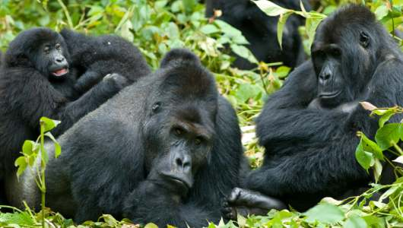
10x
A dung beetle is not only the world’s strongest insect but also the strongest animal on the planet compared to body weight. They can pull 1,141 times their own body weight. This is the equivalent of an average person pulling six double-decker buses full of people.

Slide 26
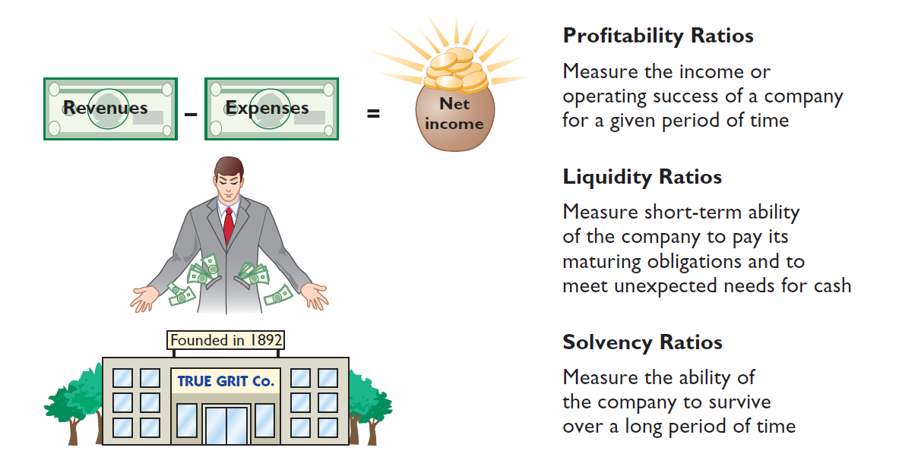
RATIO ANALYSIS
ILLUSTRATION 2-9
Financial ratio classifications
LO 2

Slide 27
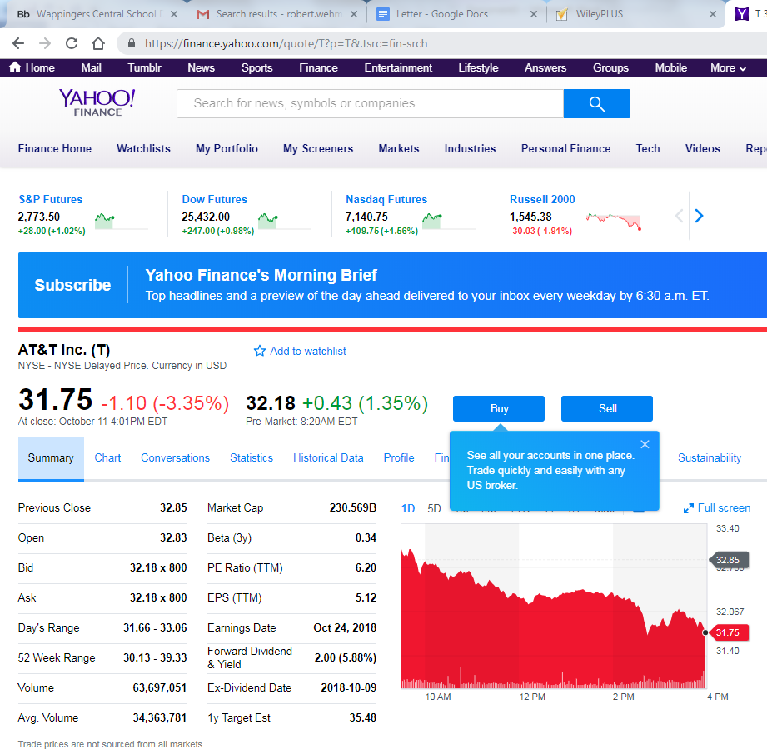
RATIO ANALYSIS
ILLUSTRATION 2-9
Financial ratio classifications
LO 2

Slide 28
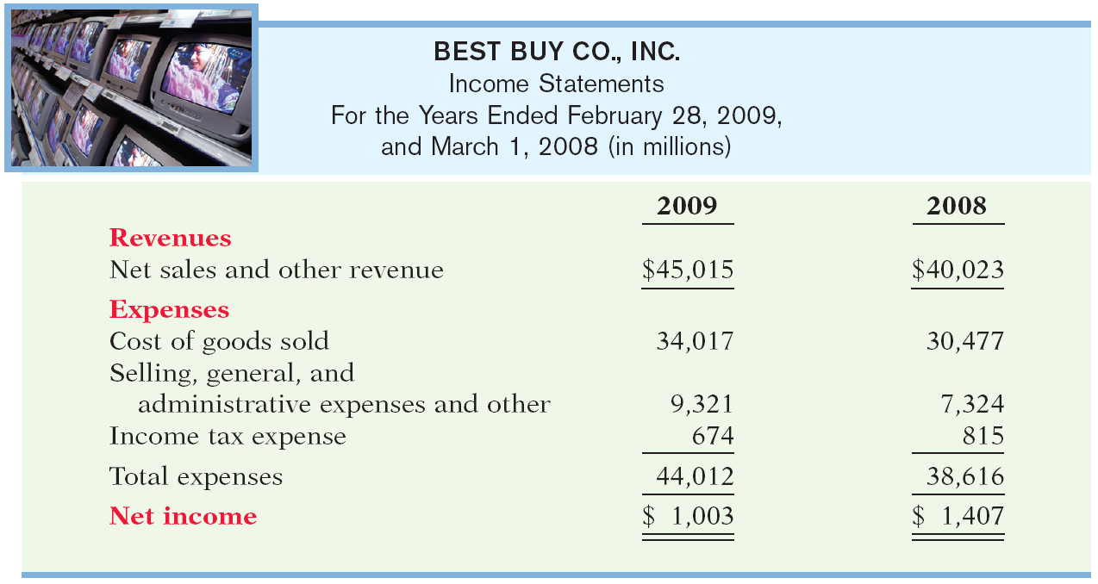
USING THE INCOME STATEMENT
Illustration 2-10
ILLUSTRATION 2-10
Best Buy’s income statement
LO 2

Slide 29
Earnings per Share
Profitability Ratio
Illustration: Earnings per share (EPS) measures the net income earned on each share of common stock.
LO 2

Slide 30
Earnings per Share
Profitability Ratio
https://www.youtube.com/watch?v=m4l1ZJyGBvY
LO 2

Slide 31
USING THE INCOME STATEMENT
Review Question
For 2017 Stoneland Corporation reported net income $26,000; net sales $400,000; and average shares outstanding 6,000. There were preferred stock dividends of $2,000. What was the 2017 earnings per share?
$4.00
$0.06
$16.67
$66.67
$26,000
- $2,000
= $4.00
6,000
LO 2

Slide 32
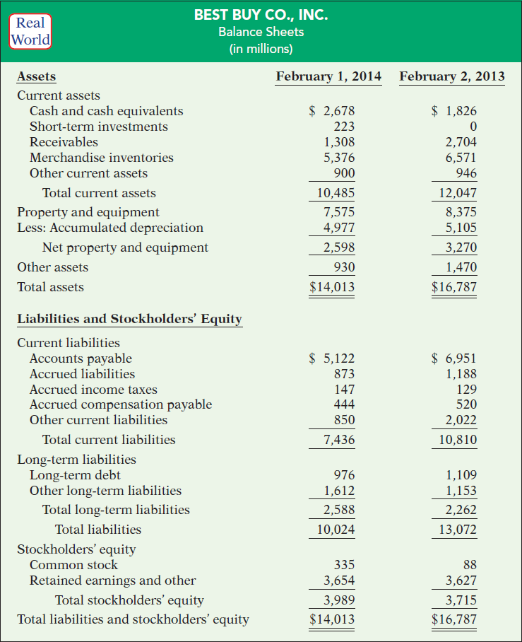
USING A CLASSIFIED BALANCE SHEET
Illustration 2-12
Best Buy’s balance sheet

Slide 33
USING A CLASSIFIED BALANCE SHEET
Liquidity—the ability to pay obligations expected to become due within the next year or operating cycle.
Working capital is the difference between the amounts of current assets and current liabilities.
ILLUSTRATION 2-13
Working capital
Best Buy had working capital in 2014 of $3,049 million ($10,485 million − $7,436 million).
LO 2

Slide 34
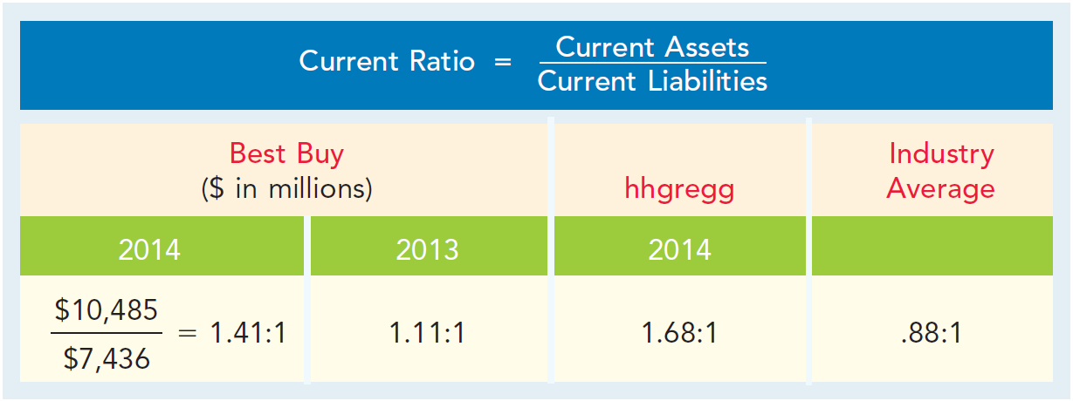
USING A CLASSIFIED BALANCE SHEET
Liquidity ratios measure the short-term ability to pay maturing obligations and to meet unexpected needs for cash.
2014
ILLUSTRATION 2-14
Current ratio
For every dollar of current liabilities, Best Buy has $1.41 of current assets.
LO 2

Slide 35
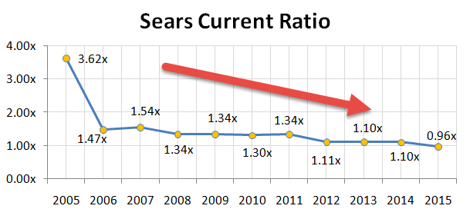

Slide 36
ACCOUNTING ACROSS THE ORGANIZATION
Can a Company Be TOO Liquid?
LO 2

Slide 37
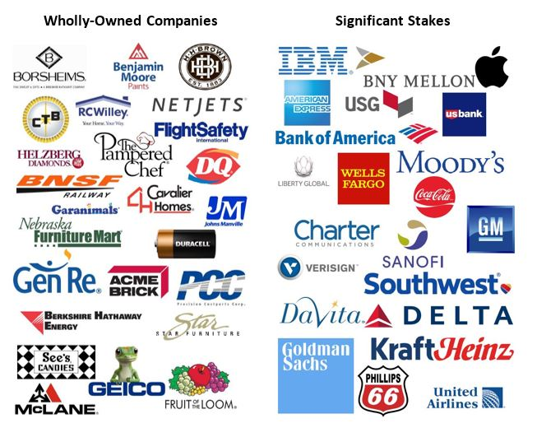
ACCOUNTING ACROSS THE ORGANIZATION
Berkshire Hathaway
BRK.A

Slide 38
USING A CLASSIFIED
BALANCE SHEET
Solvency—the ability to pay interest as it comes due and to repay the balance of a debt due at its maturity.
Solvency ratios measure the ability of the company to survive over a long period of time.
▼Helpful Hint Some users evaluate solvency using a ratio of liabilities divided by stockholders’ equity. The higher this “debt to equity” ratio, the lower is a company’s solvency.
LO 2

Slide 39
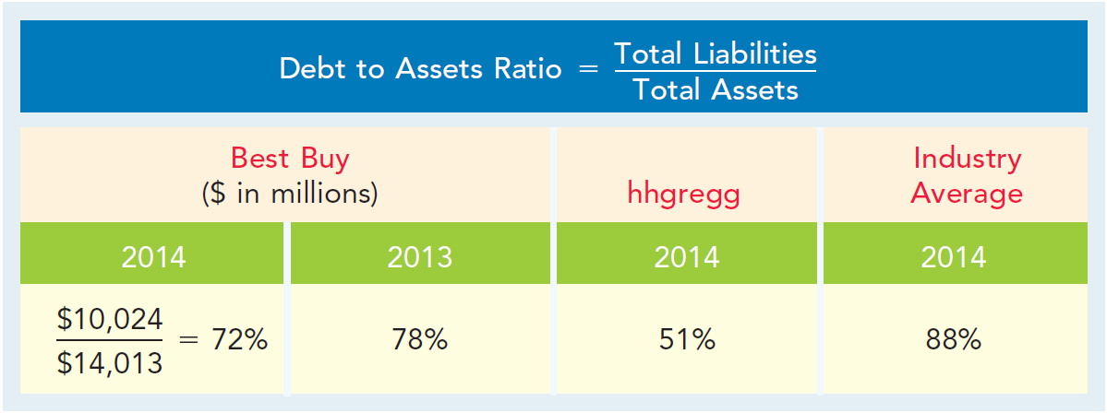
USING A CLASSIFIED BALANCE SHEET
Debt to assets ratio measures the percentage of total financing provided by creditors rather than stockholders.
ILLUSTRATION 2-15
Debt to assets ratio
The 2014 ratio means that every dollar of assets was financed by 72 cents of debt.
LO 2

Slide 40
INVESTOR INSIGHT
When Debt Is Good
Debt financing differs greatly across industries and companies. Here are some debt to assets ratios for selected companies in a recent year:
Debt to
Assets Ratio
Google 23%
Nike 41%
Microsoft 48%
ExxonMobil 48%
General Motors 74%
LO 2

Slide 41
USING THE STATEMENT OF CASH FLOWS
In the Statement of Cash Flows, cash provided by operating activities fails to take into account that a company must invest in new property, plant, and equipment and must maintain dividends at current levels to satisfy investors.
Free cash flow describes the net cash provided by operating activities after adjusting for capital expenditures and dividends paid.
ILLUSTRATION 2-16
Free cash flow
LO 2

Slide 42
USING THE STATEMENT OF CASH FLOWS
Illustration: MPC produced and sold 10,000 personal computers this year. It reported $100,000 cash provided by operating activities. In order to maintain production at 10,000 computers, MPC invested $15,000 in equipment. It chose to pay $5,000 in dividends. Calculate free cash flow.
Cash provided by operating activities $100,000
Less: Expenditures on property, plant, and equipment -15,000
Dividends paid 5,000
Free cash flow $ 80,000
LO 2

Slide 43
DO IT!
2
Ratio Analysis
The following information is available for Ozone Inc.
2017 2016
Current assets $ 88,000 $ 60,800
Total assets 400,000 341,000
Current liabilities 40,000 38,000
Total liabilities 120,000 150,000
Net income 100,000 50,000
Net cash provided by operating activities 110,000 70,000
Preferred dividends 10,000 10,000
Common dividends 5,000 2,500
Expenditures on PP&E 45,000 20,000
Shares outstanding at beginning of year 60,000 40,000
Shares outstanding at end of year 120,000 60,000
LO 2

Slide 44
DO IT!
2
Ratio Analysis
(a) Compute earnings per share for 2017 and 2016 for Ozone. Ozone’s primary competitor, Frost Corporation, had earnings per share of $2 in 2017.
SOLUTION
Earnings per
share
LO 2

Slide 45
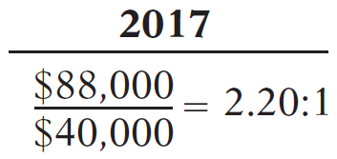
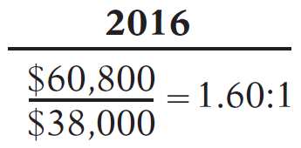
DO IT!
2
Ratio Analysis
Compute the current ratio and debt to assets ratio for 2017.
SOLUTION
Current
Ratio
Debt to Assets ratio
LO 2

Slide 46
DO IT!
2
Ratio Analysis
Compute free cash flow for each year.
SOLUTION
2017
2016
Net cash provided by operating activities $110,000 $70,000
Expenditures on PP&E − 45,000 − 20,000
Preferred dividend − 10,000 − 10,000
Common dividends − 5,000 − 2,500
$ 50,000 $ 37,500
LO 2

Slide 47
LEARNING OBJECTIVE
3
Discuss financial reporting concepts.
The Standard-Setting Environment
Generally Accepted Accounting Principles (GAAP) - A set of rules and practices, having substantial authoritative support, that the accounting profession recognizes as a general guide for financial reporting purposes.
Standard-setting bodies determine these guidelines:
Securities and Exchange Commission (SEC)
Financial Accounting Standards Board (FASB)
International Accounting Standards Board (IASB)
Public Company Accounting Oversight Board (PCAOB)
International Note Over 115 countries use international standards (called IFRS).
LO 3

Slide 48
THE STANDARD-SETTING ENVIRONMENT
Review Question
Generally accepted accounting principles are:
a set of standards and rules that are recognized as a general guide for financial reporting.
usually established by the Internal Revenue Service.
the guidelines used to resolve ethical dilemmas.
fundamental truths that can be derived from the laws of nature.
LO 3

Slide 49
INTERNATIONAL INSIGHT
The Korean Discount
If you think that accounting standards don’t matter, consider recent events in South Korea. For many years, international investors complained that the financial reports of South Korean companies were inadequate and inaccurate. Accounting practices there often resulted in huge differences between stated revenues and actual revenues. Because investors did not have faith in the accuracy of the numbers, they were unwilling to pay as much for the shares of these companies relative to shares of comparable companies in different countries. This difference in share price was often referred to as the “Korean discount.” In response, Korean regulators decided that companies would have to comply with international accounting standards. This change was motivated by a desire to “make the country’s businesses more transparent” in order to build investor confidence and spur economic growth. Many other Asian countries, including China, India, Japan, and Hong Kong, have also decided either to adopt international standards or to create standards that are based on the international standards.
Source: Evan Ramstad, “End to ‘Korea Discount’?” Wall Street Journal (March 16, 2007).
LO 3

Slide 50
QUALITIES OF USEFUL INFORMATION
According to the FASB, useful information should possess two fundamental qualities, relevance and faithful representation.
Relevance Accounting information has relevance if it would make a difference in a business decision. Information is considered relevant if it provides information that has predictive value, that is, helps provide accurate expectations about the future, and has confirmatory value, that is, confirms or corrects prior expectations. Materiality is a company-specific aspect of relevance. An item is material when its size makes it likely to influence the decision of an investor or creditor.
LO 3

Slide 51
QUALITIES OF USEFUL INFORMATION
According to the FASB, useful information should possess two fundamental qualities, relevance and faithful representation.
Faithful Representation Faithful representation means that information accurately depicts what really happened. To provide a faithful representation, information must be complete (nothing important has been omitted), neutral (is not biased toward one position or another), and free from error.
LO 3

Slide 52
ENHANCING QUALITIES OF USEFUL INFORMATION
Comparability results when different companies use the same accounting principles.
Information is verifiable if independent
observers, using the same methods, obtain similar results.
Information has the quality of understandability
if it is presented in a clear and concise fashion.
Consistency means that a company uses the same accounting
principles and methods from year to year.
For accounting information to have relevance, it must be timely.
LO 3

Slide 53
ACCOUNTING ACROSS THE ORGANIZATION
What Do These Companies Have in Common?
Another issue related to comparability is the accounting time period. An accounting period that is one-year long is called a fiscal year. But a fiscal year need not match the calendar year. For example, a company could end its fiscal year on April 30 rather than on December 31. Why do companies choose the particular year-ends that they do? For example, why doesn’t every company use December 31 as its accounting year-end? Many companies choose to end their accounting year when inventory or operations are at a low point. This is advantageous because compiling accounting information requires much time and effort by managers, so they would rather do it when they aren’t as busy operating the business. Also, inventory is easier and less costly to count when its volume is low. Some companies whose year-ends differ from December 31 are Delta Air Lines, June 30; The Walt Disney Company, September 30; and Dunkin’ Donuts, Inc., October 31. In the notes to its financial statements, Best Buy states that its accounting year-end is the Saturday nearest the end of January.
LO 3

Slide 54
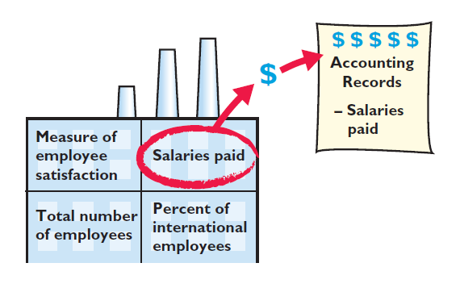
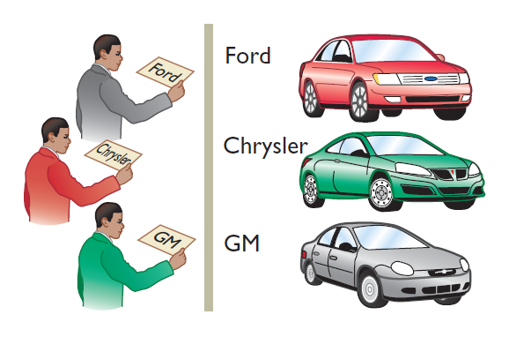
ASSUMPTIONS IN FINANCIAL REPORTING
Monetary Unit
Economic Entity
Requires that only those things that can be expressed in money are included in the accounting records.
States that every economic entity can be separately identified and accounted for.
ILLUSTRATION 2-19
Key assumptions in financial reporting
LO 3

Slide 55
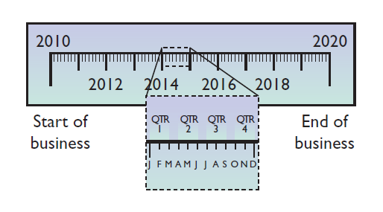
ASSUMPTIONS IN FINANCIAL REPORTING
Periodicity
Going Concern
States that the life of a business can be divided into artificial time periods.
The business will remain in operation for the foreseeable future.
LO 3

Slide 56
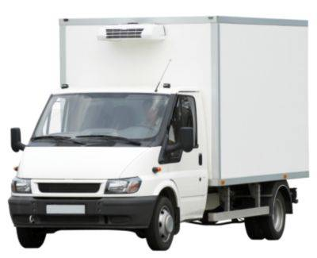
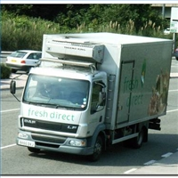
PRINCIPLES IN FINANCIAL REPORTING
Measurement Principles
Historical Cost
$30,000 New $ ? At 6 years old
Or cost principle, dictates that companies record assets at their cost.
Fair Value
Indicates that assets and liabilities should be reported at fair value (the price received to sell an asset or settle a liability).
Full Disclosure Principle
Requires that companies disclose all circumstances and events that would make a difference to financial statement users.
LO 3

Slide 57
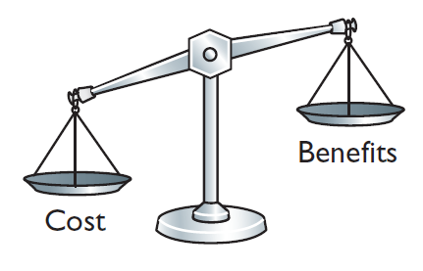
PRINCIPLES IN FINANCIAL REPORTING
Cost Constraint
Accounting standard-setters weigh the cost that companies will incur to provide the information against the benefit that financial statement users will gain from having the information available.
LO 3

Slide 58
DO IT!
3
Financial Accounting Concepts and Principles
The following items guide the FASB when it creates accounting standards.
Relevance, Periodicity assumption, Faithful representation, Going concern assumption
Comparability Historical cost principle
Consistency Full disclosure principle
Monetary unit assumption Materiality
Economic entity assumption
Match each item above with a description below.
Ability to easily evaluate one company’s results relative to another’s.
Belief that a company will continue to operate for the foreseeable future.
The judgment concerning whether an item is large enough to matter to decision-makers.
LO 3

Slide 59
DO IT!
3
Financial Accounting Concepts and Principles
The following items guide the FASB when it creates accounting standards.
Relevance Periodicity assumption
Faithful representation Going concern assumption
Comparability Historical cost principle
Consistency Full disclosure principle
Monetary unit assumption Materiality
Economic entity assumption
Match each item above with a description below.
Ability to easily evaluate one company’s results relative to another’s.
Belief that a company will continue to operate for the foreseeable future.
The judgment concerning whether an item is large enough to matter to decision-makers.
Comparability
Going concern
Materiality
LO 3

Slide 60
DO IT!
3
Financial Accounting Concepts and Principles
The following items guide the FASB when it creates accounting standards.
Relevance Periodicity assumption
Faithful representation Going concern assumption
Comparability Historical cost principle
Consistency Full disclosure principle
Monetary unit assumption Materiality
Economic entity assumption
Match each item above with a description below.
The reporting of all information that would make a difference to financial statement users.
The practice of preparing financial statements at regular intervals.
The quality of information that indicates the information makes a difference in a decision.
Full disclosure
Periodicity
Relevance
LO 3

Slide 61
DO IT!
3
Financial Accounting Concepts and Principles
The following items guide the FASB when it creates accounting standards.
Relevance Periodicity assumption
Faithful representation Going concern assumption
Comparability Historical cost principle
Consistency Full disclosure principle
Monetary unit assumption Materiality
Economic entity assumption
Match each item above with a description below.
Belief that items should be reported on the balance sheet at the price that was paid to acquire the item.
A company’s use of the same accounting principles and methods from year to year.
Tracing accounting events to particular companies.
Historical cost
Consistency
Economic entity
LO 3

Slide 62
DO IT!
3
Financial Accounting Concepts and Principles
The following items guide the FASB when it creates accounting standards.
Relevance Periodicity assumption
Faithful representation Going concern assumption
Comparability Historical cost principle
Consistency Full disclosure principle
Monetary unit assumption Materiality
Economic entity assumption
Match each item above with a description below.
The desire to minimize errors and bias in financial statements.
Reporting only those things that can be measured in dollars.
Faithful representation
Monetary unit
LO 3

Slide 63
THE STANDARD-SETTING ENVIRONMENT
Review Question
What is the primary criterion by which accounting information can be judged?
Consistency.
Predictive value.
Usefulness for decision making.
Comparability.
LO 3

Slide 64
A Look at IFRS
LEARNING OBJECTIVE
4
Compare the classified balance sheet format under GAAP and IFRS.
KEY POINTS
Similarities
IFRS generally requires a classified statement of financial position similar to the classified balance sheet under GAAP.
IFRS follows the same guidelines as this textbook for distinguishing between current and noncurrent assets and liabilities.
LO 4

Slide 65
A Look at IFRS
KEY POINTS
Differences
IFRS recommends but does not require the use of the title “statement of financial position” rather than balance sheet.
The format of statement of financial position information is often presented differently under IFRS. Although no specific format is required, many companies that follow IFRS present statement of financial position information in this order:
Non-current assets
Current assets
Equity
Non-current liabilities
Current liabilities
LO 4

Slide 66
A Look at IFRS
KEY POINTS
Differences
Under IFRS, current assets are usually listed in the reverse order of liquidity. For example, under GAAP cash is listed first, but under IFRS it is listed last.
IFRS has many differences in terminology from what are shown in your textbook.
Both GAAP and IFRS are increasing the use of fair value to report assets. However, at this point IFRS has adopted it more broadly. As examples, under IFRS companies can apply fair value to property, plant, and equipment, and in some cases intangible assets.
LO 4

Slide 67
A Look at IFRS
LOOKING TO THE FUTURE
The IASB and the FASB are working on a project to converge their standards related to financial statement presentation. A key feature of the proposed framework is that each of the statements will be organized in the same format, to separate an entity’s financing activities from its operating and investing activities and, further, to separate financing activities into transactions with owners and creditors. Thus, the same classifications used in the statement of financial position would also be used in the income statement and the statement of cash flows. The project has three phases. You can follow the joint financial presentation project at the following link: http://ww.fasb.org/project/-financial_statement_presentation.shtml.
LO 4

Slide 68
A Look at IFRS
IFRS Practice
A company has purchased a tract of land and expects to build a production plant on the land in approximately 5 years. During the 5 years before construction, the land will be idle. Under IFRS, the land should be reported as:
land expense.
property, plant, and equipment.
an intangible asset.
a long-term investment.
LO 4

Slide 69
A Look at IFRS
IFRS Practice
Current assets under IFRS are listed generally:
by importance.
in the reverse order of their expected conversion to cash.
by longevity.
alphabetically.
LO 4

Slide 70
A Look at IFRS
IFRS Practice
Companies that use IFRS:
may report all their assets on the statement of financial position at fair value.
may offset assets against liabilities and show net assets and net liabilities on their statements of financial position, rather than the underlying detailed line items.
may report non-current assets before current assets on the statement of financial position.
do not have any guidelines as to what should be reported on the statement of financial position.
LO 4

Slide 71
COPYRIGHT
“Copyright © 2016 John Wiley & Sons, Inc. All rights reserved. Reproduction or translation of this work beyond that permitted in Section 117 of the 1976 United States Copyright Act without the express written permission of the copyright owner is unlawful. Request for further information should be addressed to the Permissions Department, John Wiley & Sons, Inc. The purchaser may make back-up copies for his/her own use only and not for distribution or resale. The Publisher assumes no responsibility for errors, omissions, or damages, caused by the use of these programs or from the use of the information contained herein.”

