Slide 1
Alcohol
Ethanol- Pure form of alcohol found in beverages.
7 calories per gram….
Blood Alcohol Concentration (BAC)
How much alcohol is in the blood
Alcohol is replacing the water in your blood

Slide 2
Laws
National Minimum Drinking Age Act
Established 1984, every state now has 21 as minimum drinking age.
New York State Legal Limit
.08
Under 21 is ZERO TOLERANCE
Zero Tolerance
Established 1996, any amount of alcohol in the system of a minor is illegal. Can’t possess, can’t purchase.

Slide 3
Organizations
MADD & SADD
Both established in 1981 when drinking and driving was out of control, due to the penalties being so minimal.
Focus:
Decrease drinking and driving
Increase severity of punishments
Raise awareness to lost lives

Slide 4
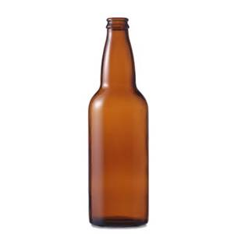
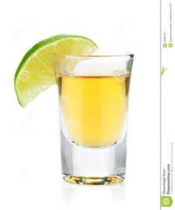
12 oz Beer = 5 oz Wine = 1.5oz Liquor
ALL THE SAME AMOUNT OF ALCOHOL

Slide 5
Proof- Is the alcohol by volume doubled.
40% alcohol equals 80 proof.
70 proof would equal 35% alcohol.
18th century they would mix liquor with gunpowder and light it. The bigger & brighter the explosion, the more pure the liquor. Resulting in the selling “proving” their product was pure and strong.

Slide 6
Influences of Alcohol in the body
What is affecting a person’s BAC?
Body weight
Gender (males metabolize alcohol quicker than females)
How often a person drinks (tolerance)
How much a person drinks
How quickly they drink
Use of drugs/medications (increases effects & dangers)
Food consumption/empty stomach

Slide 7
Alcohol absorbs into your bloodstream.
Liver oxidizes (breaks down) 90% of the alcohol consumed.
Liver can only break down .5 ounces an hour.
Basically 1 drink per hour!
Only thing that sobers a person up is TIME!

Slide 8
Cirrhosis
Damaging and destroying of liver tissue and cells.
Scar tissue covers healthy tissue and blocks blood flow.
The scarring impairs the liver's ability to:
Control infections
Remove toxins from blood
Process nutrients
Clot your blood
Produce bile

Slide 9
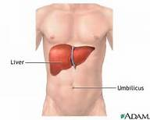
2-3 alcoholic drinks a day puts a person at high risk for cirrhosis. Drinking heavily 1-2 days a week poses the same risk!
Liver has over 250 functions
Weighs about 3 pounds
Largest organ in the body

Slide 10
“Do Now”
What does BAC stand for?
The only thing that sobers a person up is…
How much alcohol can your liver oxidize per hour?
List 3 factors that affect your BAC.
How many ounces of beer, equals how many ounces of wine, equals how many ounces of liquor?
What organ is responsible for oxidizing alcohol?
What year was the drinking age of 21 set in every state?

Slide 11
Binge Drinking
Men consuming 5 or more alcoholic drinks, or women consuming 4 or more alcoholic drinks in a short period of time.
Binge drinkers are 14 times more likely to drive drunk.
Binge drinkers are at a higher risk for STDS and pregnancy.
1 in 6 US adults binge drink.
Binge drinkers are 60% more likely to have liver related disease.
80,000 deaths a year in the US are due to the result of binge drinking.

Slide 12
At The Bell Assignment”
What is the name of the law that minors are in violation of when they are caught with any amount of alcohol in their system or possession?
How many drinks for a man, and how many for a woman in a short period of time would classify as binge drinking?
Alcohol ________________ into your bloodstream.
Pure form of alcohol found in beverages is called…..
90% of alcohol is metabolized by the liver, how does your body eliminate the other 10% (Hint: 3 things)

Slide 13
Abusive
No self-control
Not knowing your limit
Drinking to get drunk
Danger to yourself or others
Drinking and getting sick
Binge drinking
Giving into peer pressure
Alcohol poisoning
Drinking to cope
Hangovers
Moderate
Every once and awhile
Controlled
Responsibly
1-2 drinks
Self-control
Maturely
Not a danger to self or others
Knows their limits
Avoids pressures
Addictive
Drinking alone
Craving alcohol
Drinking at any hour of the day (morning/night)
Drinking daily
Can’t be around alcohol without drinking
Alcoholism
Physically needing it to function
Impacts finances, family, job, health.

Slide 14
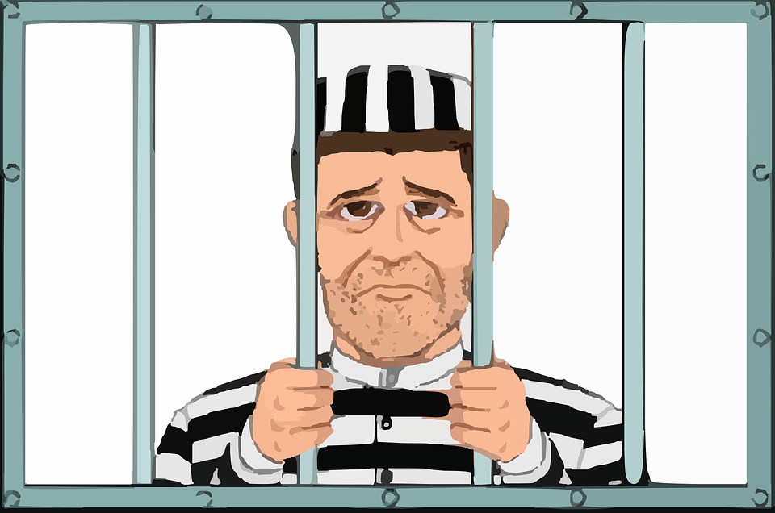
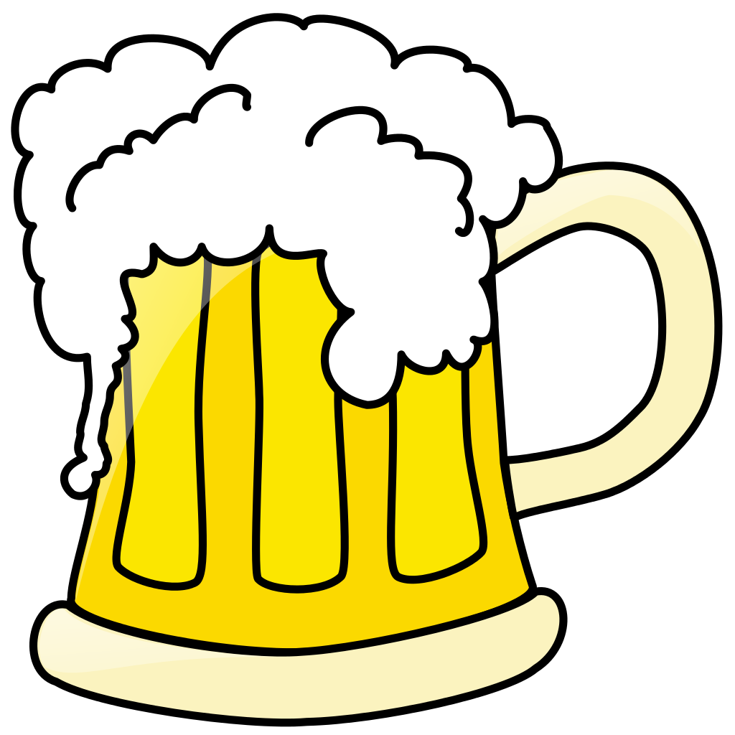
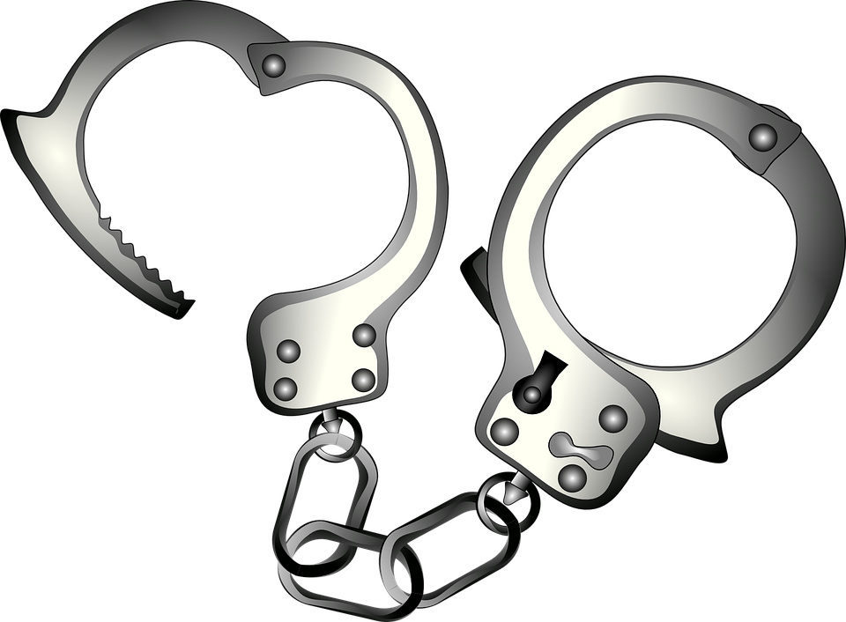
Lowering the Drinking Age in US, maybe?
You are to debate the topic of the drinking age. Why you believe it should be lowered to 18, or why it should remain the age of 21? Use details to support your position (positives/negatives).
Minimum of 1 full page, do not skip lines
Write neatly and clear
Be intelligent with your points

Slide 15
Alcohol Poisoning “Do Now”
What is the first thing you do when you observe the signs of alcohol poisoning with somebody?
Define alcohol poisoning.
If not already in that position, how would you position a person with alcohol poisoning?
Ethanol slows down…..
List 3 signs of alcohol poisoning.
Tell me 2 long term risks of alcohol use.

Slide 16
Alcoholism is a family disease…..
Impacts relationships
Finances (job/income)
Responsibilities ( cook/clean/maintain home)
Health of family members (stress/anxiety/depression)
Creates hostility/anger/fear
Increased risk of divorce & domestic violence
Impacts kids with school or sports
Unpredictable behaviors of the drinker
Crime/Jail
Increased risk of being in alcohol related accident
fires, falls, driving, drowning, injury resulting in bleeding

Slide 17
Alcohol & Medications “Do Now”
What happens when people mix alcohol and prescription drugs?
What effects does it have on the body?
Why are prescription drugs gaining such popularity amongst drug users?

Slide 18
Alcohol & Medications
Mixing enhances effects of both
Most overdose deaths are when combined
Cause internal bleeding
Significantly slows down breathing
Alcohol and sedatives compete for the same enzyme, which slows the clearance from the body. The result is that drugs/alcohol stay in the blood longer and in higher concentrations.

Slide 19
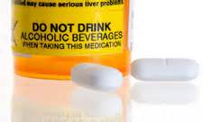
Overdose death due to alcohol & medicine complications
Prince
Heath Ledger
Derek Boogaard
Amy Winehouse
Anna Nicole Smith
Michael Jackson
Whitney Houston
Joan Rivers
Chris Farley
Jimi Hendrix
Elvis Presley
Hank Williams Sr.
Bruce Lee
7 out of 10 teens who abuse prescription pills are mixing them with alcohol.
Elderly are at the highest risk for mixing

Slide 20
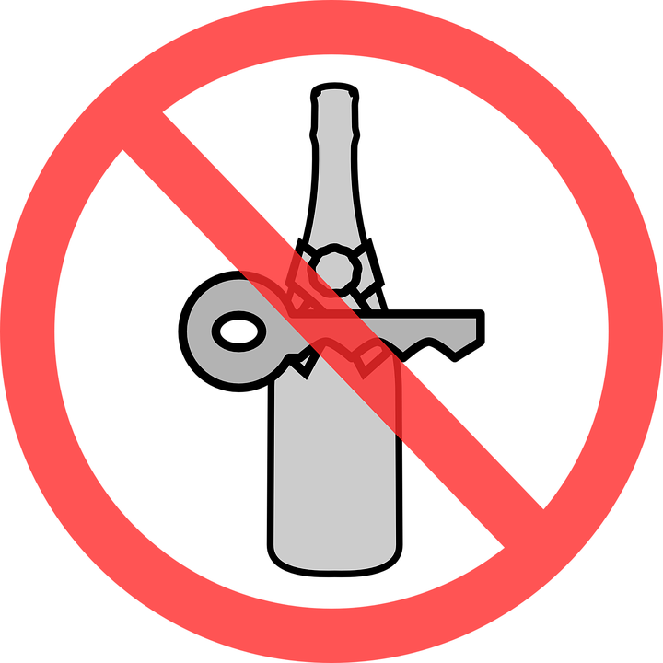
Drinking & Driving
Penalties & Laws
On average, every 40 minutes in the United States somebody is KILLED in a drinking and driving related vehicle accident. What do you propose as new laws or penalties to minimize the drinking and driving that takes place in this country. Please be realistic in your plan…use course notes, statistics, and facts.
Use details and be specific to support your proposals.
Minimum 1 page, do not skip lines, simple heading, write neat.

Slide 21
Alcohol Exam Review
Is alcohol digested or absorbed when consumed?
What does BAC measure?
How many drinks for men makes it binge drinking? For women?
First thing you do if you think somebody has alcohol poisoning?
Only thing that sobers a person up is?
Why is alcohol a depressant?
What is the legal limit for operating a motor vehicle?
60 proof would equal _________%

