Slide 1
Plot structure, Conflict, and theme

Slide 2
Plot structure
Plot is the literary element that describes the structure of the story.
Plot shows the causal arrangement of events and actions within a story.

Slide 3
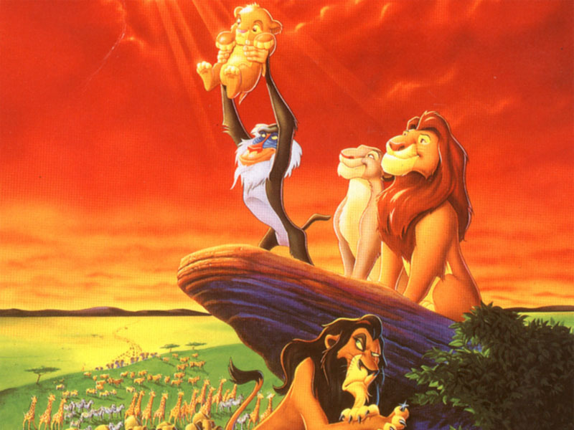
Plot structure: Exposition
Sets the scene
Author introduces the setting and characters
Provides description and background information
Example

Slide 4
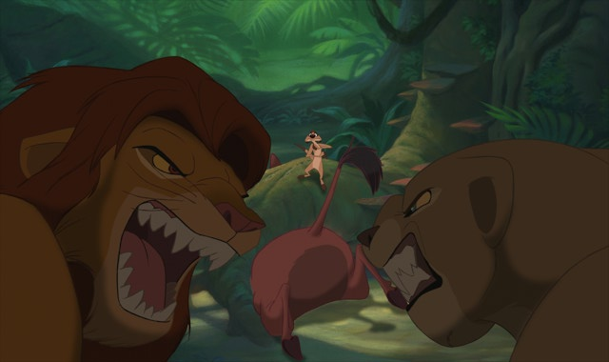
Plot structure: Rising action
Series of conflicts and crises in the story that lead to the turning point
Example

Slide 5
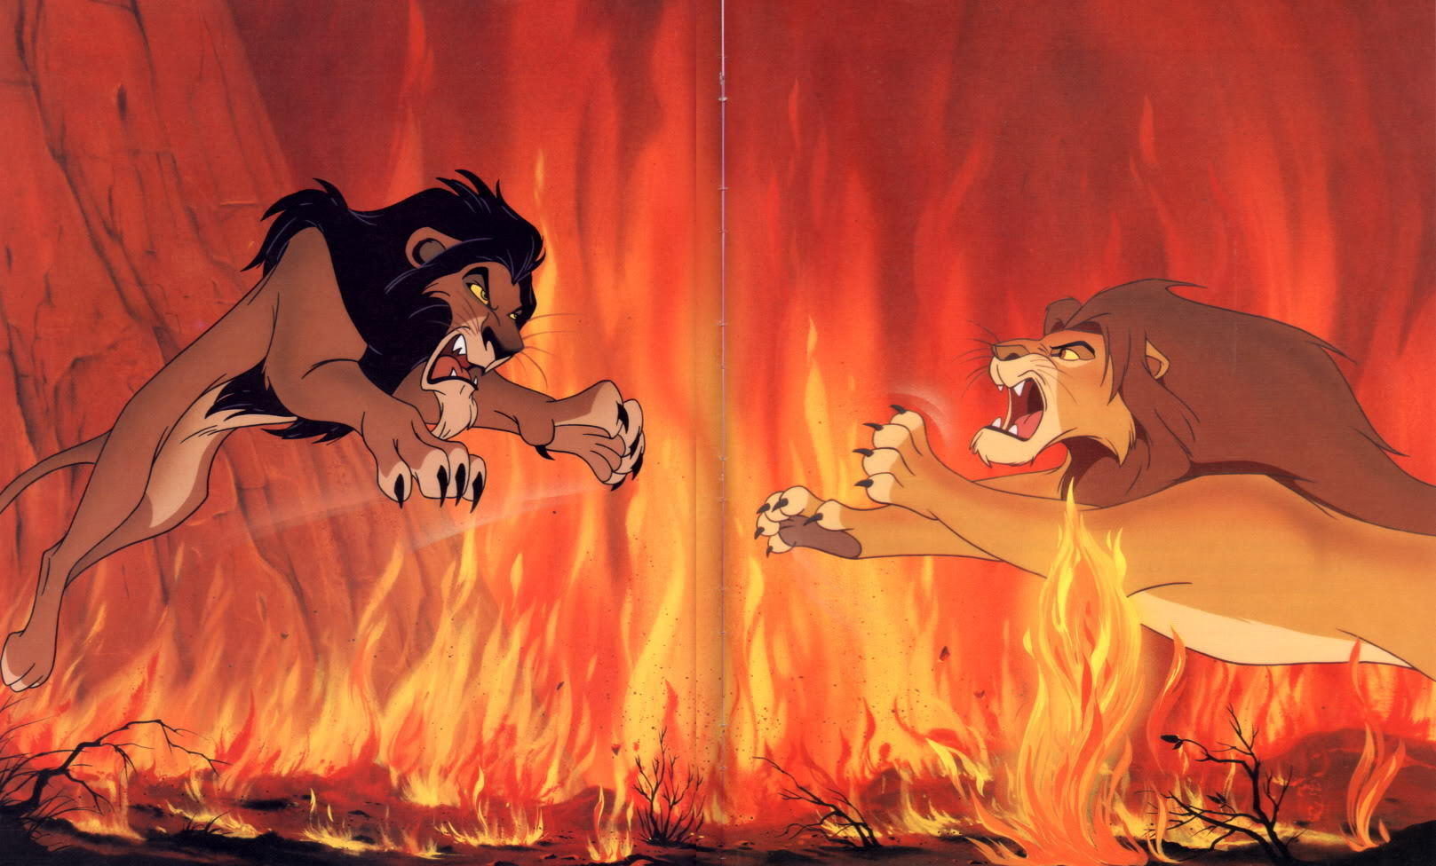
Plot structure: climax
Also called the “turning point”
Event that the rising action and central conflict leads up to
Place where plot turns or “changes direction” toward a resolution
Example

Slide 6
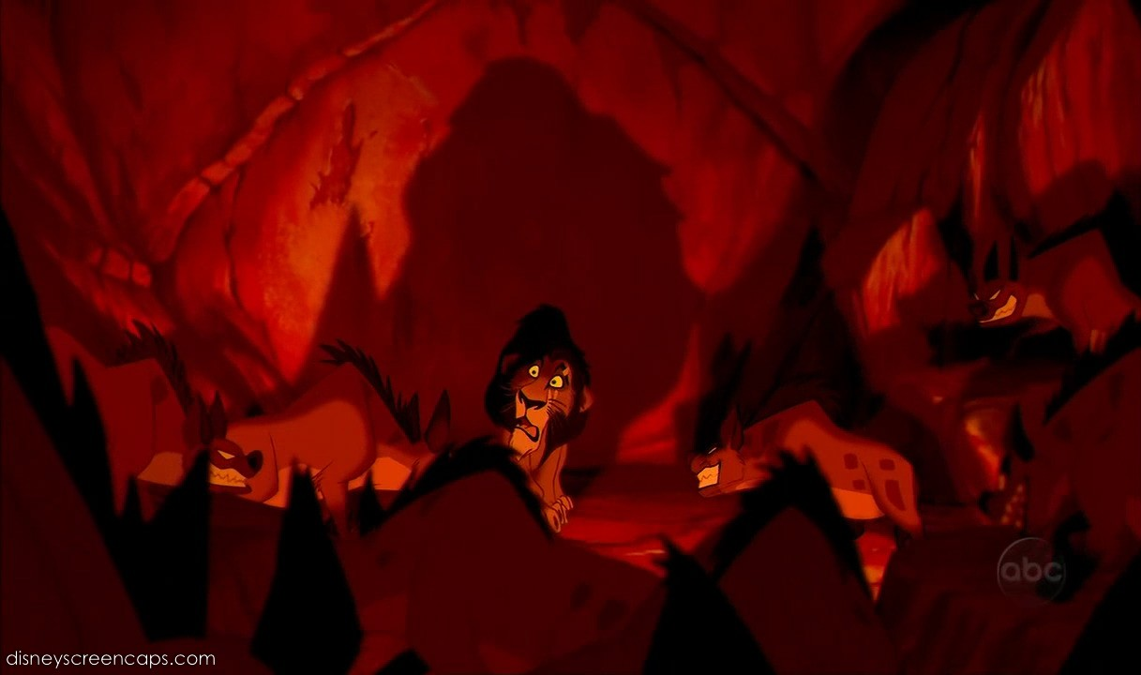
Plot structure: falling action
Events that happen as a result of the climax as the conflict grows closer to being resolved
Example

Slide 7
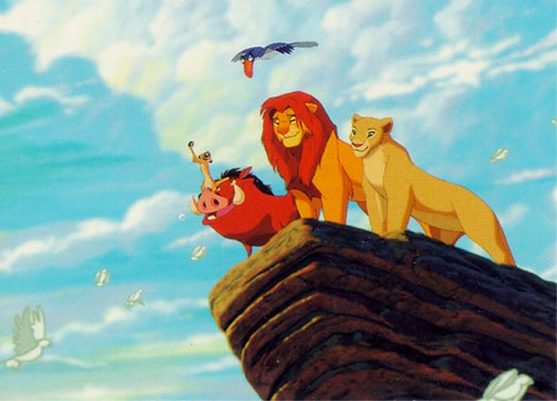
Plot structure: resolution
Main conflict is solved or resolved
Example

Slide 8
conflict
Without conflict, there is no plot!
Usually introduced during the rising action
Faced head-on during the climax
Begins to work itself out during the falling action
Is resolved during the resolution

Slide 9
conflict
Internal
Character vs Him- or Herself
Struggle takes place in character’s own mind
Usually something to do with choice or overcoming emotions or mixed feelings
External
Character vs Character
Protagonist vs antagonist
Character vs Nature
Usually character is struggling to survive
Character vs Society
Group of characters fighting against society
Character fights against social traditions or rules

Slide 10
Other types of conflict
Character vs Supernatural
Gods, ghosts, monsters, spirits, aliens, etc.
Character vs Fate
Fight for choice; fight against destiny
Character vs Technology
Computers, machines, etc.

Slide 11
theme
The theme is the universal message about truth or life that is communicated by a literary work
Life lesson
Meaning
Moral
Message about life or human nature
Theme is NOT just one word like “love,” or “happiness”
Theme is expressed in at least one sentence:
Money can’t buy happiness
It is better to die free than live under tyranny

Slide 12
How do we find the theme?
Sometimes explicit (directly stated)
Most often in fiction, the theme is implicit (hinted at or suggested)
Themes can be inferred through:
Metaphors
Similes
Personification
Imagery
Tone of voice
Symbols

Slide 13
Tips for identifying the theme
Look closely at the title for clues
Look for ideas that are repeated more than once
Look for lessons that the character(s) learns
Think about what happens in the story and how it can apply to real life

